Slide 1
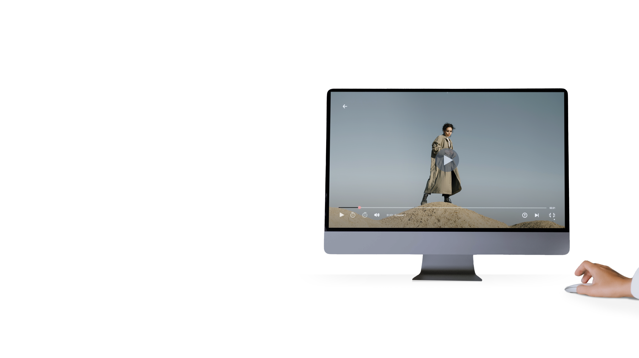
Watch, cancel, and go streamers

Slide 2
Methodology
03.
04.
13.
19.
25.
27.
28.
Introduction
The streaming landscape today
Consumers who consider cancelling
Winning back subscribers
Talking points
Want to know more?
More from GWI
All figures in this report come from GWI’s online research among internet users aged 16-64, so it’s fair to say they reflect the online populations of each market.
In some markets - mainly in Latin America, Middle East and Africa, and the Asia-Pacific region - low internet penetration means online populations tend to be younger, more affluent and better educated than the total population.
When reading this report, please note that we use a mixture of data from our ongoing quarterly global research and insights from GWI Zeitgeist, which is a monthly study carried out in the following 12 markets: Australia, Brazil, Canada, China, France, Germany, India, Italy, Japan, Singapore, UK, USA.

Slide 3
As more streaming services have come onto the scene in recent years, one consumer habit is creating cause for concern for brands – consumers are picking up streaming services, but then quickly dropping them.
Referred to as “watch, cancel and go streamers” these consumers are creating more competition to retain viewership, challenging brands to frequently review their content and pricing. Over 30% of internet users across 11 markets are considering cancelling or have already cancelled at least one streaming service.
In this deck, we’ll show you how the attitudes of streamers are changing, and how to keep them from canceling.
Please note you’ll only be able to click on the links in Slide Show mode. If you’re viewing this file in Edit mode, please right-click on the icon and select “Open Hyperlink”.

Slide 4
The streaming
landscape today

Slide 5

Ways to watch streaming
Devices used to watch streaming services
% of internet users who use the following devices to watch on-demand/streaming services
Despite the mobility offered by streaming on portable devices such as laptops or cell phones, the majority of viewers still consume content on their TV set, capturing the viewership of over 50% of consumers across all generations.
Although the TV might still be the top way to watch, younger generations are more likely to be diversifying their content viewing across multiple devices.
Gen Z and millennials are more likely to watch streaming content on mobile devices then older generations, and even though game consoles are the fifth most popular way to watch streaming, millennials are 27% more likely to watch on this device than the average internet user.
But it’s not just about how you watch - who you watch with has an impact on what device is used too. Those who live with a partner, children, and their parents are more likely to watch on a TV than those who live with other family members, alone or with roommates where a phone or tablet is the preferred way to watch.
Source: GWI Core Q2 2022 Base: 244,231 internet users aged 16-64
Notes:
https://bit.ly/3eRLpXX

Slide 6
Millennials are watching the most
Over the past year, average daily streaming time has increased across all generations aside from baby boomers, with millennials having watched the most streaming on average. But millennials are also the generation that is most likely to think about cancelling a streaming platform.
Paying for multiple services is beginning to become cause for concern as price continues to be a key factor when making decisions about the number of streaming services owned, particularly for millennials and Gen Z.
Content can be one way to continue to capture the attention of millennials but a key component as to why millennials are considering cancelling is because they are paying for too many services. 32% of millennials across 12 markets have reduced their spending on in-home entertainment in the last 3 months. As many reprioritize their finances, the rising costs may be influencing where millennials are cutting back.
Average daily watch time by generation
HH:MM avg of time watched on streaming platforms
Source: GWI Core Q2 2021-Q2 2022 Base: 1,105,090 internet users aged 16-64
Notes:
https://bit.ly/3TYdz2h

Slide 7
Purchase of streaming services has plateaued
Movie and TV streaming content purchased in the last month
% who have purchased streaming services in the past month
Increased services and pandemic shifts in content viewing in recent years has helped grow streaming popularity but now the market seems too saturated – streaming has plateaued. Since Q3 2020, when streaming purchases started to level off, we have yet to see similar gains from previous years.
Netflix’s recent growth in subscribers indicates that even without pandemic restrictions, streaming content remains popular, after almost 90% of internet users say they’ve watched a streaming service in the last month. It’s clear that streaming services need to innovate in order to keep their current subscribers and potentially gain new ones, but potential burnout from too much content is also influencing consumer cancellations – simply having too much choice is leading to a greater sense of streamer fatigue.
Source: GWI Core Q1 2018-Q2 2022 Base: 3,073,732 internet users aged 16-64
Notes:
https://bit.ly/3W7MpI2

Slide 8
Streaming burnout
Those who have or are considering cancelling a streaming service are also the consumers who watch more content on average than viewers who are not considering cancelling a subscription. Even respondents without a streaming service still manage to watch 37 minutes of streaming per day, but this is likely a result of shared accounts.
But while those who watch more are more inclined to consider cancelling, brands should also consider the viewers state of mind when watching shows. Many consumers (51%) say they feel happy when watching TV/movies. In a close battle for second place are calm (39%), engaged (40%), and excited (40%). On the other hand, just 12% say they feel distracted. And while that varies based on the genre’s consumers watch, “happy” is always the top state of mind when it comes to any of the genres we track.
We watch content because it’s a positive, engaging experience - which is crucial to remember when aiming to maintain subscribers and avoid streamer fatigue.
Average daily hours of streaming watched
Time spent watching streamed content by attitudes towards streaming plans for those considering canceling a TV streaming service
Source: GWI Zeitgeist June 2022 Base: 14,324 internet users aged 16-64 in 11 markets
Notes:
https://bit.ly/3W7MpI2

Slide 9
Reasons for cancelling streaming services
Reasons streaming services are cancelled
% of consumers who have cancelled one or more TV streaming service subscriptions
Price and usage are the top reasons users cancel their streaming services, and 29% of consumers cannot justify their continued subscriptions because they aren’t using them enough.
19% of consumers site their favorite show being cancelled as a reason to end a subscription, a problem all too familiar for HBO, who experienced a drop in subscriptions in 2019 following the season finale of Game of Thrones.
But usage is likely a contributing factor behind the price and paying for too many services. Multiple subscriptions can add up quickly which can break budgets. Budgeting is top of mind for consumers. In the last three months, 30% of consumers report spending less on streaming, and in the US, we’ve seen a 10%9% increase in consumers using tools to help track their spending in the last month since Q2 2021. Average daily streaming time may be up but that doesn’t mean there is room for multiple subscriptions in every budget.
Source: GWI Zeitgeist June 2022 Base 1,546 consumers who have cancelled one or more TV streaming subscriptions aged 16-64 in 11 markets
Notes:
https://bit.ly/3DeS32q

Slide 10
Consumers who consider cancelling

Slide 11
Millennials consider cancelling the most
Cancelation profile by demographic
% of internet users and their plans to cancel streaming platforms by generation
Streamers on average subscribe to 2.8 platforms, but millennials subscribe on average to 3.1. They have also seen the highest growth in subscriptions year-on-year increasing 84% since 2015 according to our millennials marketing guide. Competing for the attention of millennials and Gen Z in the streaming space is going to become increasingly difficult as the market saturates. With rising prices, millennials and Gen Z may be more inclined to cancel – especially as multiple subscriptions can lead to large monthly bills.
But millennials spend more time watching streaming than traditional TV services, making streaming their most common form of entertainment consumption. Alongside paying for too many streaming services, lack of new content is a consideration too. 24% of millennial streamers have cancelled a service due to lack of new content being added.
Source: GWI Zeitgeist June 2022 Base: 3,558 internet users who are considering or have canceled one or more TV subscriptions aged 16-64 in 11 markets
Notes:
https://bit.ly/3swKgrQ

Slide 12
APAC streamers are leading the way in cancellations
The Asia Pacific region has the highest portion of consumers who are planning to cancel or have already cancelled a streaming service. Streamers in APAC are 10% more likely to cancel because their favorite show was removed. APAC streamers are also 9% more likely to consider cancelling if another service has new content. Brand loyalty may be harder for streaming platforms in the region to hold onto. Consumers in APAC who are considering cancelling are 40% more likely than the average internet user to want brands to engage in community forums. Communicating with consumers on forums is a great way to keep customers engaged, and these consumers are also 32% more likely to promote a brand if they have access to exclusive content or services – favoring exclusivity, access and communication are key values for these consumers.
Streaming cancellation consideration by region
% of Internet users planning to cancel streaming services
Source: GWI Zeitgeist June 2022 Base: 3,558 internet users who are considering or have canceled one or more TV subscriptions aged 16-64 in 11 markets
Notes:
https://bit.ly/3swKgrQ

Slide 13
Streamers considering canceling are fans of the cinema
Comfort for the big screen has been making a slow comeback, and for those who are considering cancelling, other lifestyle activities such as eating out, fast food, and drinking alcohol are regular activities, but visiting the cinema takes the top spot.
The experience of viewing in a movie theater is still yet to be fully replicated at home, tailoring new content that appeals to streamers lifestyle choices is an example of how brands can win back users. Competing with movie-goers has always been a challenge, but with recent exclusive deals for blockbuster movie content, and streaming content available at select movie theatres before offering to subscribers, we may see more hybrid forms of movie content in the future to engage subscribers that potentially cancel.
Lifestyle trends of streamers
% of consumers considering cancelling a streaming service who do the following at least once a month
Source: GWI Core Q1 2022 Base: 2,012 internet users considering canceling their TV streaming subscriptions aged 16-64 in 11 markets
Notes:
https://bit.ly/3TDuck4

Slide 14
Winning back subscribers

Slide 15
Content is key for subscribers
Reasons for subscribing to a streaming service
% of internet users who find the following important when paying for a film/TV streaming service
61% of consumers say that relevant content is important when subscribing to a streaming service. This beats price at 52%. Relevant content is the number one priority for consumers who pay for a streaming service, and content overall, no matter if new, original or a large offering is an extremely important factor.
In fact, 4 out of the top 5 reasons for subscribing are content related. Content is the best way to differentiate between streaming services and is a clear winner to attract viewers to their platform.
Bundle plans such as those from Disney+ that combines their service with Hulu and ESPN is one of the lowest reasons for subscription at 18% but leveraging a variety of content could appeal to many consumers and multiple users. Alongside a variety of content, the more user profiles per service could also rescue the likelihood of a subscription being cancelled by appealing to a wider audience.
*includes “Content relevant to my interests”, “Original content”, “New content regularly added”, “Large amount of content”
Source: GWI Zeitgeist July 2022 Base: 15,539 internet users aged 16-64 in 12 markets
Notes:
https://bit.ly/3faEE3u

Slide 16
Product placement is not a popular option
Introducing product placement onto a platform may harm retention rates of viewers who are considering cancelling.
Using product placement to cut production costs and retain viewers may be an unpopular option among those who are considering cancelling. 38% of consumers who are considering cancelling prefer to see companies promote products through more conventional advertising methods.
And these consumers are more aware product placement too. 40% of customers who are considering cancelling notice product placement every time they watch TV shows compared to 25% for the average streamer. Brands should be wary of introducing product placement, because for some, this might be enough to persuade them to cancel.
Attitudes towards product placement
% of internet users who are considering canceling at least one streaming service
Source: GWI Zeitgeist June 2022 Base : 2,012 internet users considering canceling a TV streaming subscription aged 16-64 in 11 markets
Notes:
https://bit.ly/3TWpjCs

Slide 17
Ad tiers may be the right move for user retention
Cancelers largely support ads
% of consumers, who canceled a streaming service subscription, that say the following about using an ad-supported streaming service
Those considering cancellation support ad tiers even more
% of consumers, who are considering cancelling streaming service subscription, that say the following about using an ad-supported streaming service
Ad tiers could be very effective for retaining customers who are on the fence about their streaming service. Netflix recently announced its introduction of an ad-supported service for its US customers, offering a lower price point than its standard service. For viewers considering cancelling a streaming service 36% strongly support ad tiers compared to 14% for those who have already canceled. 45% of those who have canceled support or strongly support the introduction of advertisements to reduce costs. And 67% of viewers who are considering cancellation would support some ad-based tier at a lower price. This support shows that ads may be more effective on streaming platforms because many consumers are in favor of lower priced streaming services. Ultimately ads in streaming services could help retain subscribers and are largely not opposed by viewers.
Source: GWI Zeitgeist June 2022 Base: 1,546 internet users who have canceled one or more TV streaming subscriptions aged 16-64 in 11 markets and 2,012 internet users considering canceling TV streaming subscriptions
Notes:
https://bit.ly/3U43Pnn

Slide 18
Ways to watch
The TV set is still the most popular way to watch streaming. However other devices are gaining usage with younger generations.
Millennials are 27% more likely to watch on a game console than the average internet user, and mobiles are the number one way for Gen Z to stream. Streaming services need to keep this in mind when catering different shows across age demographics.
Streamer fatigue
Streamers on average subscribe to 2.8 platforms, and those who watch more are more inclined to consider cancelling. Brands should also consider the viewers state of mind when watching shows. “Happy” is the top state of mind when it comes to any of the genres we track. We watch content because it’s a positive, experience - which is crucial to remember when maintaining subscribers.
Content is key
61% of consumers say content is the reason they subscribe. Even though price and lack of usage are top reasons for those who do cancel, over 1 in 5 consumers have cancelled a streaming service due to not enough new content being added.
Content is the best way to differentiate between streaming services and is a clear winner to attract viewers to streaming platforms.
Ads can work
Ad supported tiers may be the way forward for those wishing to cut costs but still enjoy streaming content. 67% of streamers who are considering cancelling support ads to reduce costs, and less than 10% of consumers have any opposition to ads. But streaming services should be aware consumers are less inclined to want to see product placement as a form of advertising.

Slide 19

Want to know more?
Jack Seasholtz
Consumer Trends Analyst
jseasholtz@gwi.com

Slide 20

Explore more content
on our platform
Travel habits by generation
Secondhand shoppers
Mind the gap: Nordics & UKI
Why people work

