Slide 1
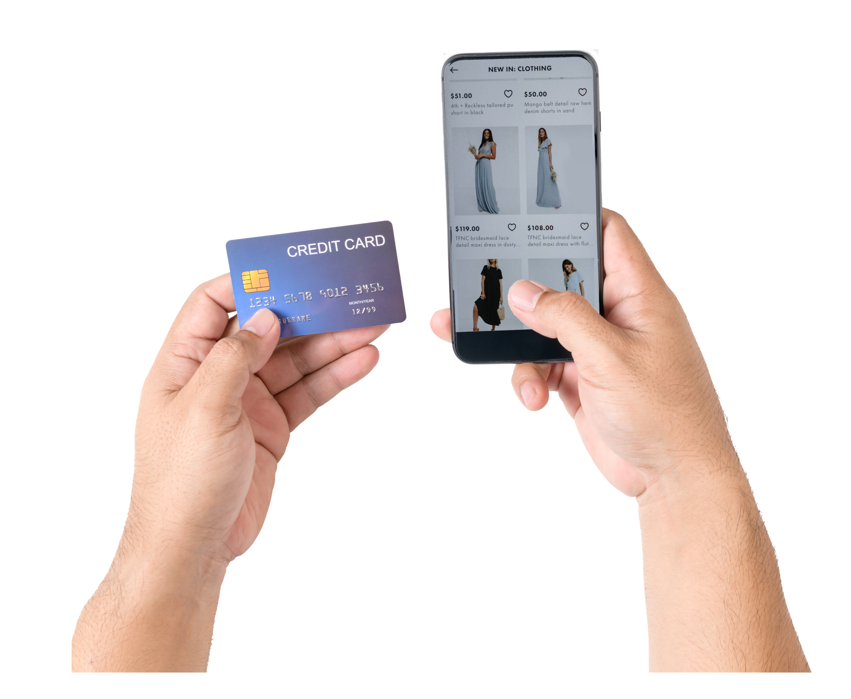

What consumers really think about buy now, pay later

Slide 2
03.
04.
08.
12.
20.
21.
Introduction
The economic state of play
How BNPL services have evolved
Profiling BNPL users & prospects
Talking points
Want to know more?
All figures in this report come from GWI’s online research among internet users aged 16-64, so it’s fair to say they reflect the online populations of each market.
In some markets - mainly in Latin America, Middle East and Africa, and the Asia-Pacific region - low internet penetration means online populations tend to be younger, more affluent and better educated than the total population.
When reading this report, please note that we use a mixture of data from our ongoing quarterly global research and insights from GWI Zeitgeist, which is a monthly study carried out in 12 markets.
In this report, we define buy now, pay later users as those who used a service of this kind in the last week. Prospective BNPL users are defined as those interested in using these services in the future. Please note this question was only asked to consumers in 12 markets.

Slide 3
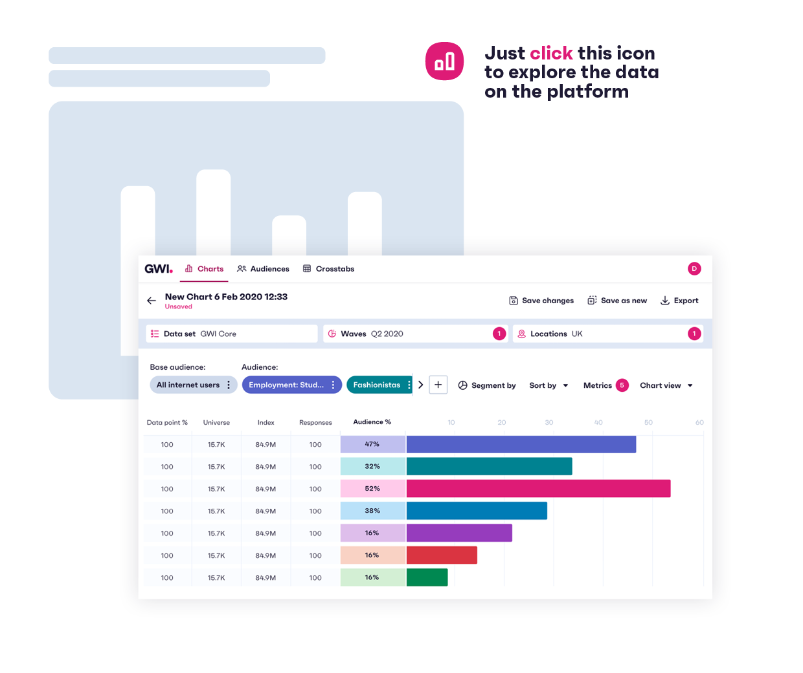
Introduction
You may have noticed the option to buy now, pay later when purchasing products online. Whether it’s clothing, tech, or even a takeaway meal, the option to delay spending through a BNPL service is a temptation that’s getting harder to ignore. As the cost of living keeps on rising, more are looking for ways to balance their spending – especially when BNPL offers low to zero rates of interest. But these services are largely unregulated, meaning there are some big pitfalls to be wary of.
Using our data, this report looks closer at why consumers would opt to buy now, pay later, and why nailing the right messaging is so important.
Please note you’ll only be able to click on the links in Slide Show mode. If you’re viewing this file in Edit mode, please right-click on the icon and select “Open Hyperlink”.

Slide 4
The economic state of play

Slide 5

Financial concerns are growing, again
Future attitudes
% of consumers who expect the following to get better in the next 6 months
Consumers’ financial outlook is complicated at the moment. Our data shows they’re more optimistic about the future of their country’s economy or their personal finances than they were two years ago, but pessimism is creeping in as the global economy worsens.
In 11 markets, over 1 in 5 say the price of products currently has them most worried right now, while a further 18% say the same about their personal finances. It’s a time for tightening purse strings and financial savviness, which is a promising backdrop for buy now, pay later (BNPL) services.
Existing BNPL users are much more likely than average to be optimistic about their finances, to say they buy premium versions of products, and to describe themselves as affluent. But it’s likely the current situation will draw in new users who aren’t as confident money-wise and are using BNPL services for slightly different reasons. Brands and BNPL providers will therefore have to prepare for a shift in the latter’s user base.
Source: GWI Core 2019-2022 (averages of respondents conducted between Q3 2019-Q2 2022) Base: 2,320,104 internet users aged 16-64

Slide 6
In many places, expenses are higher than last year
Monthly expenses in 2022
% of consumers who say they spend more than 50% of their monthly household income on bills/expenses, and the % change compared to last year
In 12 markets, 41% of consumers say they spend over half of their monthly household income on bills/expenses – no different to what they spent in 2021.
But it’s easy to miss, from a top–level perspective, how devastating the events of the last year have been on some people’s finances.
In just 4 markets (Brazil, China, Italy, and Japan) are fewer consumers spending over half their income on bills/expenses. For the remaining 8 markets, 2022 is proving much harder – especially in the UK, where the winter promises to be a particularly challenging time for billpayers. It’s probably no coincidence then that use of BNPL services here has grown 33% since this time last year.
In short, times are hard right now. However, it’s not as though consumers are only spending on the essentials. Things like housing, bills, and food take priority, but even in difficult financial periods, people still look for small luxuries with which to treat themselves.
YoY % change
+6%
0%
+5%
-3%
+6%
+6%
+1%
-2%
-3%
+5%
+18%
+2%
Source: GWI Zeitgeist September 2022 Base: 15,329 internet users aged 16-64 in 12 markets

Slide 7

BNPL in the financial landscape
Consumers will be on the lookout for ways of affording their small luxuries without breaking the bank as the cost of living continues to bite. Among these methods are buy now, pay later services – a means of consumers spreading out payments, often without incurring any interest.
Tipped to surpass $1 trillion by 2030, these services are no laughing matter.
These services are definitely no longer limited to “premium” products. As a 2019 report by The Initiatives Group put it, “BNPL started with online retailers in higher margin product categories” like jewellery or high-end fashion, whereas today, Boohoo said its average customer spend per item using BNPL was “relatively low”, at £11.96.
The need for treats during these hard times crops up in our research; the number of Gen Z who say they’d rather sacrifice other spending to buy a product instead of save up for it has grown 9% since Q2 2021. Whatever the reason – whether it’s a YOLO mentality or pent-up desire for spending – BNPL services hold a lot of appeal.

Slide 8
How BNPL services have evolved

Slide 9
Searches for BNPL are up since the pandemic
Financial difficulties associated with the pandemic really put these BNPL services on the map, with data from Google Trends showing a clear rise in searches for the term from mid-2020 onward. More retailers are adding BNPL services to their checkouts too, so it’s easy to see why consumers are becoming more aware of them.
While it’s not the case for all, Covid was an opportunity for some everyday consumers to stockpile their earnings. It makes a lot of sense; most activities were off-limits, travel was largely a no-go, and mass working from home meant an end to everyday commuting charges. Our data backs this up also, with the number describing themselves as affluent climbing 20% worldwide since Q2 2020.
Since then, however, that figure has plateaued – no doubt a by-product of all things cost of living. Consumers are spending money again, and more look at BNPL as a means of doing this strategically.
Searches are growing even if uptake is slow
Global popularity of searches for the following
2019
2021
2020
2022
Source: Google Trends, Worldwide

Slide 10
Short-term loans and credit cards are bouncing back
Financial products/practices
% of consumers who…
Weekly BNPL engagement
% of consumers say they’ve used a BNPL service in the last week
Attitudes are changing; the number of Americans who say they’re happy to use credit/loans to buy things they can’t afford has risen 21% since 2020. And the number of consumers who own a credit card or a short-term loan is on the up too. As more become comfortable borrowing money again, there’s a solid opportunity for BNPL to grow, as long as financial literacy grows alongside this trend.
Interest rates are a problem that’s likely to be front-of-mind for consumers considering them – especially at a time where the price of everything is going up. Low earners, particularly in European or North American markets, are significantly less likely to currently own credit cards or loans, so even if they’re growing in popularity again, not everyone will be eager to rely on them for financial support.
That’ll probably be a key factor in making BNPL services more accessible. Low-earners are still less likely to use them, but zero interest options or more information on payments could make them seem like more of an option.
There’s still work to be done in growing these services, but our data shows impressive signs of growth, especially in regions where adoption is lower.
YoY % change
+2%
+3%
+5%
+12%
+9%
+17%
Source: GWI Core 2017-2022 (averages of waves conducted between Q1 2017-Q2 2022) Base: 3,443,783 internet users aged 16-64
Source: GWI Q2 2021 & Q2 2022 Base: 59,239 buy now, pay later users aged 16-64

Slide 11
Top countries for BNPL usage
Top 10 markets for BNPL use
% of consumers who used a buy now, pay later service online in the last week
Bottom 10 markets for BNPL use
% of consumers who used a buy now, pay later service online in the last week
Source: GWI Core Q2 2022 Base: 244,231 internet users aged 16-64

Slide 12
Profiling buy now, pay later users & prospects

Slide 13
Who are the BNPL consumers?
So what do BNPL users actually look like? For starters, they typically skew young, with millennials the most likely to be using BNPL services every month. Younger audiences are generally newer to things like recession and financial uncertainty, but they’re typically more digitally savvy and more trusting of online financial services – so it makes sense that they’re eyeing up new and alternative methods of controlling their spending.
Baby boomers, as it turns out, aren’t so hot on the idea – preferring more traditional financial practices like using a credit card or a short-term loan. This suggests its more a matter of perception; older consumers are comfortable borrowing money, they’re just not clued up on how BNPL really works. More efforts need to be spent on increasing awareness/knowledge if they’re to take off among these consumers. Income is currently a possible barrier to entry; and actually, while the number of high earners using them has grown (+7%) in the last year, the number of low earners using them has stayed consistent. Meanwhile, 51% of low earners say they’re interested in using them. It’s therefore key that brands offer a range of options and services that cater to consumers from different backgrounds.
Generation
% of consumers in each generation who are BNPL users
Income
% of consumers in each income segment who are BNPL users
Source: GWI Core Q2 2022 Base: 244,231 internet users aged 16-64

Slide 14
They’re careful, price-conscious, and financially savvy
BNPL attitudes grab bag
% of BNPL users who say the following describe them
BNPL users tend to convey a sense of financial savviness that we might expect. Despite low rates of interest, BNPL services still carry with them a risk-factor that typical users are seemingly aware of. They’re more likely than the average consumer to partake in money-saving activities like using coupons, reward programs, or be on the lookout for better deals on products.
Likewise, just over 4 in 10 say consider themselves good at managing money. That doesn’t mean they don’t take risks or make quick decisions (34% and 42% say this respectively), but our data implies these consumers generally do their research.
In times like this, it’s a sensible mindset to have – especially when we consider the long-term implications of spending more than we can afford. The risks associated with things like credit cards and loans are well-known – the same can be said for BNPL. On the whole, BNPL users ensure they’re keeping informed, and their fondness for financial information is a reminder for brands to be transparent about payments and give customers as much choice as possible.
IDX
1.11
1.18
1.24
1.09
1.12
1.15
1.25
1.27
1.28
1.23
Source: GWI Core Q2 2022 Base: 33,740 buy now, pay later users aged 16-64

Slide 15
The prospective BNPL users
On the flip side then, what about consumers who are considering using BNPL? On the surface, they look a lot like current users; interest is much higher among all generations except baby boomers, mid-high earners, and consumers in APAC markets. Demographically, they’re very similar.
But when it comes to attitudes there’s a noticeable shift; those interested in using BNPL are somewhat less financially savvy. Make no mistake, they’re still ahead of the average when it comes to money-saving practices like researching products or looking for better deals, but these are slim over-indexes. They’re also less confident in their ability to manage money effectively, and even less price-conscious than the BNPL early adopters we observed in the previous slide. In short, these are consumers with less financial confidence.
This could be a problem. Consumers may well get weighed down with purchases they can’t afford, and it’s important for services to be as upfront as possible about the risks of BNPL as it becomes more commonplace.
BNPL interest
% of consumers in these groups who say they’re interested/not interested in using BNPL in the future
Source: GWI Zeitgeist September 2022 Base: 15,329 internet users in 12 countries aged 16-64

Slide 16
Consumers see BNPL as a convenient way to manage their spending
Reasons for interest in using a BNPL service
% of consumers who say the following are reasons they’re interested in using BNPL
Among prospective BNPL users, there’s a clear reason for being interested: it’s convenient. Generally, this makes a lot of sense. Among current BNPL users, half of them used one via their mobile. It goes deeper than this of course, but with smartphones the most widely-owned device in the world, that makes BNPL incredibly accessible to consumers – fitting online shopping around activities like watching TV or commuting.
But convenience also extends to things like the fact BNPL makes accessing/using credit easier, or that it removes the need to wait around for payday. In short, consumers see it as a low-risk method of buying things they’d normally have to save for – especially since 28% say they can use BNPL to avoid paying interest.
There are some warning signs, though. Gen Z are 15% more likely to say it saves them waiting for payday, and 10% more likely to say that it’s easier to be pre-approved for an installment loan over a credit card. Getting too caught up in the convenience of BNPL can be problematic for audiences with less spending power. Brands shouldn’t wait around for regulation to catch up with them; being honest to consumers about the consequences of misusing BNPL.
Source: GWI Zeitgeist September 2022 Base: 15,329 internet users in 12 countries aged 16-64

Slide 17
BNPL users aren’t as concerned about their finances right now
Immediate concerns
% of consumers in these groups who say they’re most concerned about the following right now
Earlier on in this report, we looked at the current financial state of play, and how consumers are growing increasingly concerned about their finances. Among 15 options, the prices of products/services has consumers most concerned, while personal finances sits neck and neck with climate change.
Now, it’s worth stating that this can be affected by several factors – age especially. But bearing in mind what we know about existing and prospective BNPL users, it shouldn’t come as much of a surprise that either of these groups consider them less troubling than the average. This could be an extension of their financial savviness, but it also suggests these consumers are generally more relaxed about their bank balance overall. BNPL prospects and users are less likely to cite any listed concerns than consumers in the 12 markets we track.
BNPL services could temper this financial optimism with real discussions about money. Chats about the current climate and ways to live well within our means could do a lot of good for brand image. As part of their content strategy, Klarna shares a series of financial wellness tips; including ways to spend more intentionally, establish financial goals, and save money each month.
Source: GWI Zeitgeist September 2022 Base: 15,329 internet users in 12 countries aged 16-64

Slide 18
BNPL users are no strangers to an impulse purchase
Cautious v carefree
% of consumers in these groups who say they’d prefer to do the following at the moment
Even though BNPL users hunt around for the best deals, they make regular impulse buys.
Since Q2 2020, consumers haven’t started splurging in droves; just shy of two-thirds still prefer to save up for products than sacrifice spending elsewhere. Our September Zeitgeist reveals this in more detail, with three quarters of consumers saying they’d prefer to be cautious about their spending right now. For those using, or interested in using, BNPL it’s a bit different. These consumers are still largely cautious about frivolous spending, but they’re more likely to make impulse purchases. Given either audience over-indexes for saying they make quick decisions, that’s probably not too surprising, but it also reveals more about the kind of person who currently uses BNPL services.
BNPL brands should be wary of how they market these services. Not everyone will know the risks, and advertising should highlight this as well as the benefits.
These consumers spend longer on social media and pay attention to influencers. So, creating or adding to an online community where people and brand ambassadors discuss their money management strategies could be hugely beneficial.
Source: GWI Zeitgeist September 2022 Base: 15,329 internet users in 12 countries aged 16-64

Slide 19
Consumers are considering BNPL for the big-ticket items
Given most prospective BNPL users have designs on making purchases they wouldn’t be able to afford till the next payday (or in the immediate short-term), it makes sense that the products they’re most keen on purchasing with BNPL are tech-related items.
This lines up when we look at the products existing BNPL users are most likely to have purchased in the last 3-6 months, and it’s the same for the kinds of products they’re planning to purchase too.
But we’re also seeing what new entrants are likely to bring to the BNPL table, especially with around a quarter hoping to use them for essentials like groceries or cleaning products.
Clothing is also worth noting. It’s the number one product consumers in a recent Zeitgeist study said they purchased for themselves as a treat in the past 6 months. Prospects eyeing up clothing purchases tend to skew younger, offering brands food for thought about which products will need more warnings or information before the sale is complete.
Purchase categories
% of consumers, who are interested in using BNPL, that would use BNPL to purchase the following
Source: GWI Zeitgeist September 2022 Base: 6,210 consumers who are interested in using a buy now, pay later service aged 16-64

Slide 20
Consumers are on the lookout for ways to manage their spending
With an ongoing cost of living crisis on their minds, consumers are starting to think more about their financial situation. Pessimism is growing as people shell out more of their earnings to stay afloat, and they’re borrowing more in the short-term. As such, BNPL services, with their low rates of interest, are a convenient and tempting alternative to the likes of credit cards and loans at this time.
Younger consumers are at the forefront of BNPL adoption
Learning to cope with a recession and financial uncertainty, younger audiences are more likely to be eyeing up BNPL services than their older counterparts.
While that’s likely to do with their low to nothing interest rates, it’s also an important reminder for brands to be transparent about the implications that come with these schemes.
BNPL users are generally more confident in managing their finances
Overall, consumers who use BNPL services tend to be more price-conscious, and generally agree they’re good at managing money. At the same time, they’re also more carefree, often opting to buy products sooner than save up. They’re sensible consumers, and while brands still need to be clear about the risks involved, BNPL users are more financially confident than most.
BNPL is most-often used for the bigger purchases
Whether it’s a recent purchase, or one they’re planning on making, our data shows that BNPL users are generally keen on using the service for the big-ticket items as opposed to covering everyday spending. For the most part, that means things like tech products or clothing are front of mind, but there’s plenty of room for growth in smaller purchases – like takeaways and groceries – too…

Slide 21

Want to know more?
Tom Morris
Trends Manager
tmorris@gwi.com

Slide 22

Explore more content
on our platform
Black Friday shopping in 2022
Watch, cancel, and go streamers
Vibe check: the 2022 World Cup
Travel habits by generation

